Slide 1
Harnessing Weather Patterns to Identify Means to Optimise Households Energy Consumption by Town

Slide 2
Who am I?
Data Analyst employed by a vendor hired by NEA to
NEA needs to target 3-5 towns in Singapore that consumes the most amount of energy
The final goal is to promote usage of energy efficiency across island

Slide 3
Problem Statement
Weather can potentially impact energy consumption as usage patterns in response to weather conditions.
By analysing the relationship between rainy days and energy consumption, we can identify opportunities to promote more efficient practices and optimise energy usage.

Slide 4
Methodology
Step 1 : Monthly weather pattern in Singapore
Step 2 : Relationship between various monthly weather data
Step 3 : Energy consumption pattern per month across town in Singapore
Step 4 : Relationship between various monthly weather data
Step 5 : Relationship between various monthly weather data and energy consumption across town

Slide 5
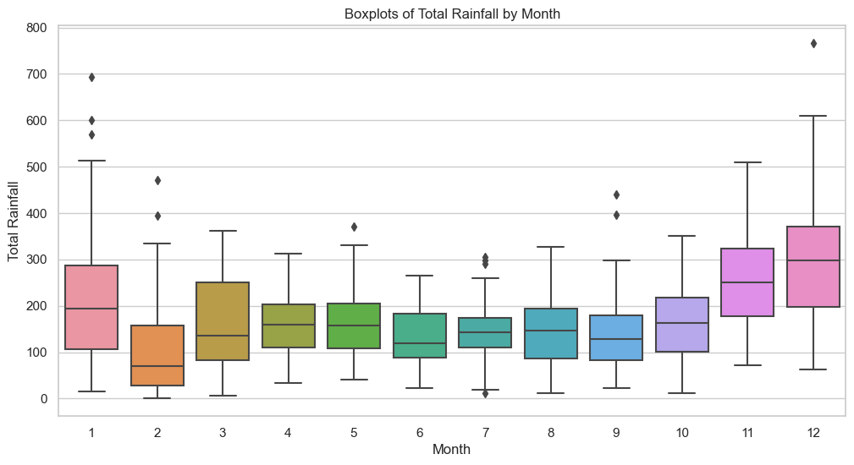
Dec is the wettest month.

Slide 6
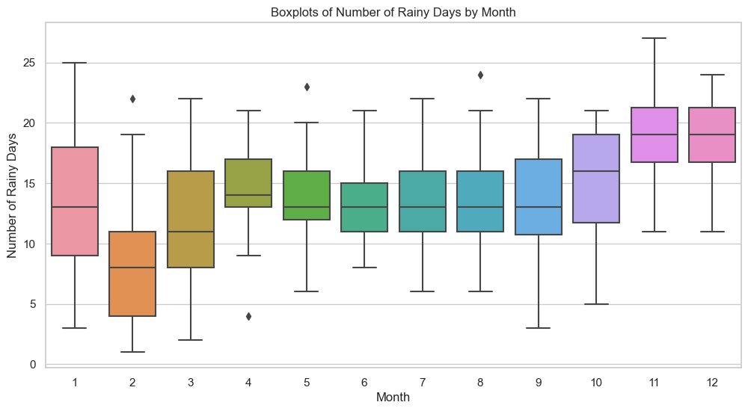
Nov – Jan rains the most.

Slide 7
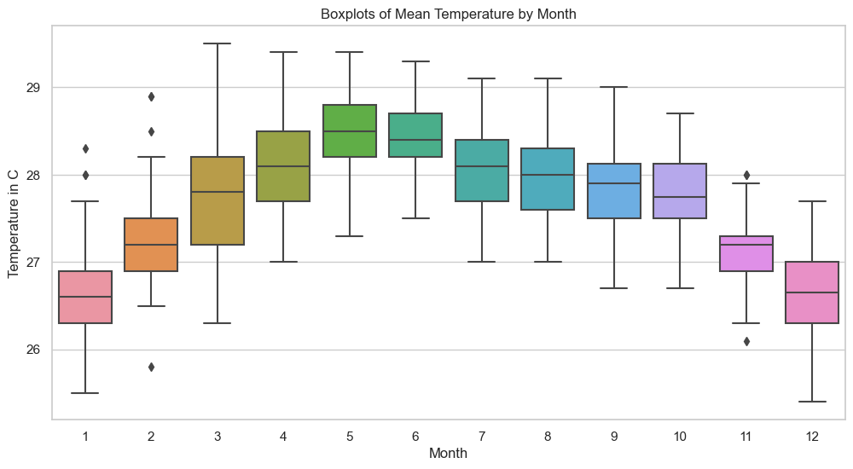
May is the hottest in Singapore

Slide 8
Step 2: Important Relationship between Weather Data
total rainfall in a month and maximum rainfall in a day have strong positive correlation (r = 0.81).
total rainfall and mean temperature have very mild (less than expected) negative correlation (r = -0.51).

Slide 9
How weather could potentially connect to energy consumption
Possibility 1
People stays at home more during rainy seasons
=> More household energy consumption
Possibility 2
Air-conditioner / Water Heater are used more during hot seasons
More household energy consumption

Slide 10




Major Source of Energy Consumption in Household
5-ticks AC
200 to 250 kWh per month
Refrigerator
6 kWh per
wash/dry cycle
Water Heater
60 to 80 kWh per month
Washer/Dryer
6 kWh per
wash/dry cycle

Slide 11
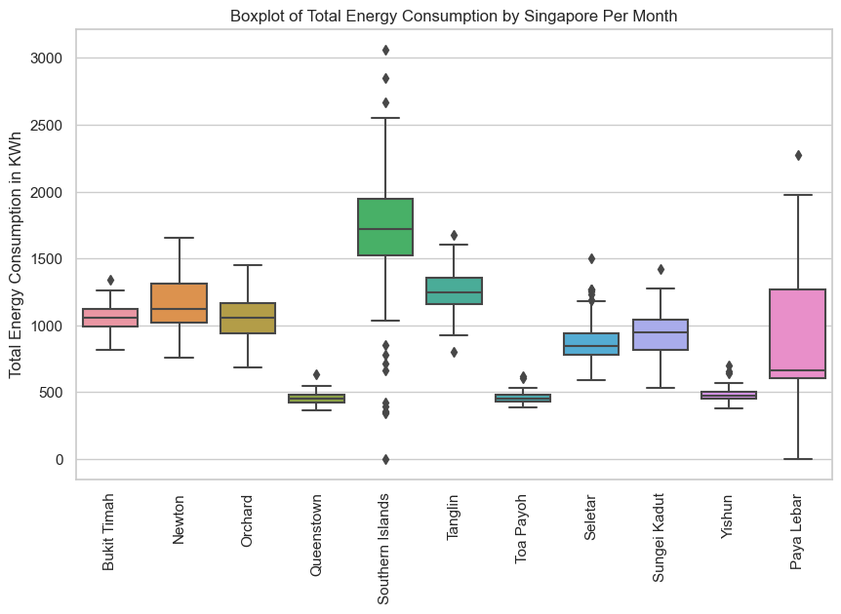
mean
648 kWh per month

Slide 12
Step 3: Energy Consumption Patterns
Energy Area | Average Household Consumption per Month (kwh) | Mean Household Consumption per Month (kWh) | Multiplier
Bukit Timah | 1058 | 648 | 2x
Newton | 1164 |  | 2x
Orchard | 1063 |  | 2x
Paya Lebar | 907 |  | 1.5x
Seletar | 869 |  | 1.4x
Southern Island | 1574 |  | 3x
Tanglin | 1253 |  | 2x
Sungei Kadut | 932 |  | 1.5x

Slide 13
Opportunities
Area | Multiplier | Possible Reason
Bukit Timah | 2x | Landed Properties
Newton | 2x
Orchard | 2x
Tanglin | 1.5x
Southern Island | 1.4x
Paya Lebar | 3x | Proximity to Airport
Seletar | 2x
Sungei Kadut | 1.5x | Light Industrial Area

Slide 14
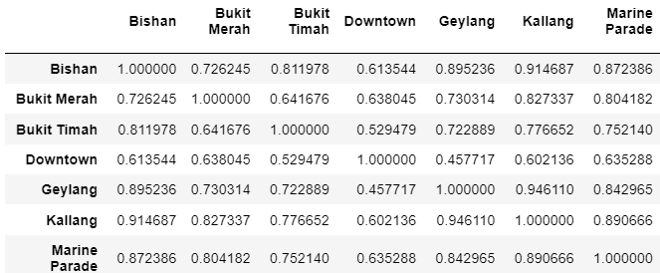
The table below shows a collection of correlation coefficients (r) between the variables below.
For example, Energy Consumption in Bishan is 0.726245 correlated with Bukit Merah.

Slide 15
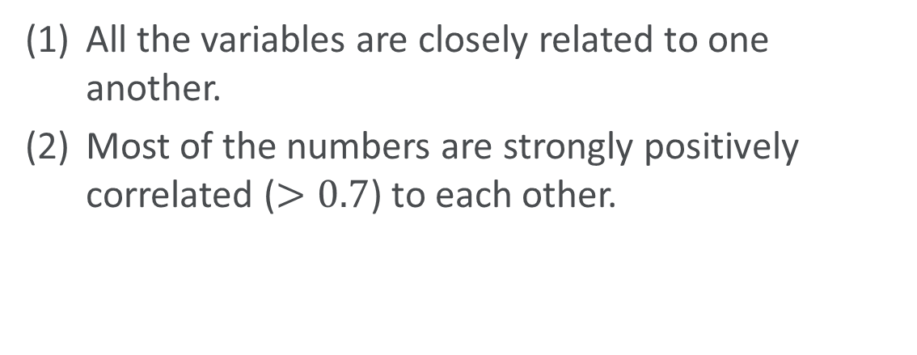
Relationship between Energy Consumption across town
All the variables are closely related to one another.
Most of the numbers are strongly positively correlated ($>0.7$) to each other.

Slide 16
Relationship between Energy Consumption across town
The energy consumption patterns across towns are similar.
Push for one successful campaign in a town
Expand our campaigns to all towns

Slide 17
Summary of Insights
The recommendations from us will not be weather-dependent.
Bukit Timah, Newton, Orchard, Tanglin and Southern Islands are
top target audience for energy consumption campaign
the campaign will be electricity consumption focused
Any successful recommendations are expandable to all other towns due to the high level of similiarity between energy consumption patterns across areas.

Slide 18
Appendix
Boxplot of Monthly Electricity Consumption across all towns
Boxplot of Monthly Electricity Consumption across selected towns
Boxplot of Monthly Gas Consumption across all towns
Boxplot of Monthly Gas Consumption across selected towns
Boxplot of Monthly Total Energy Consumption

Slide 19
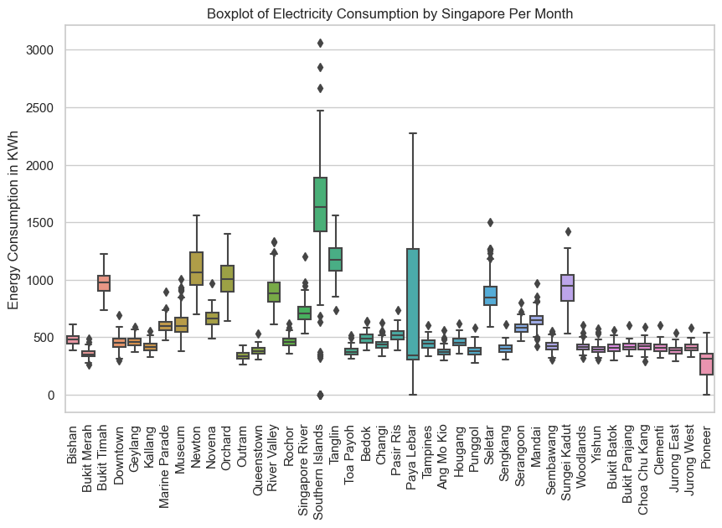

Slide 20
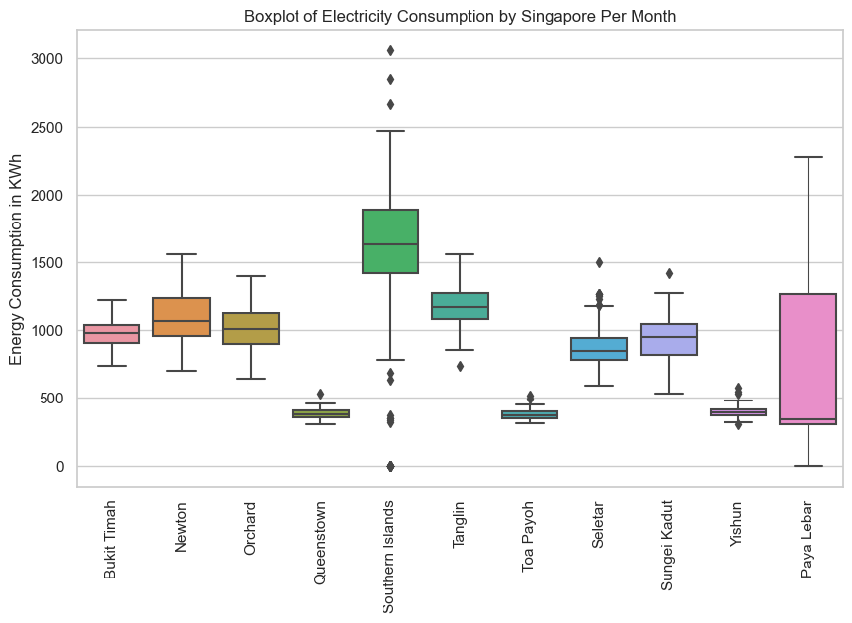

Slide 21
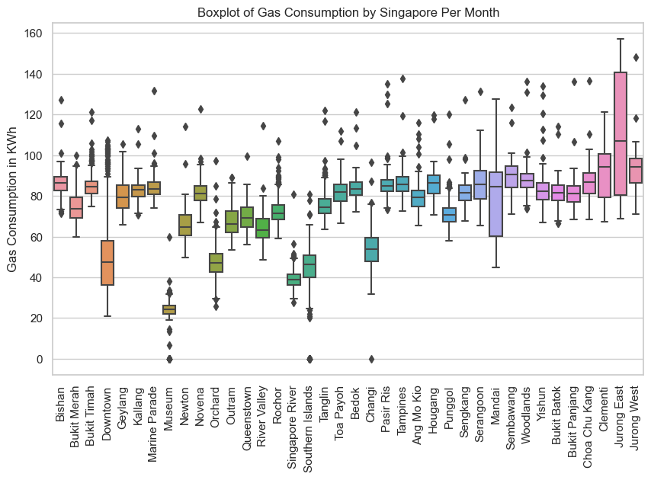

Slide 22
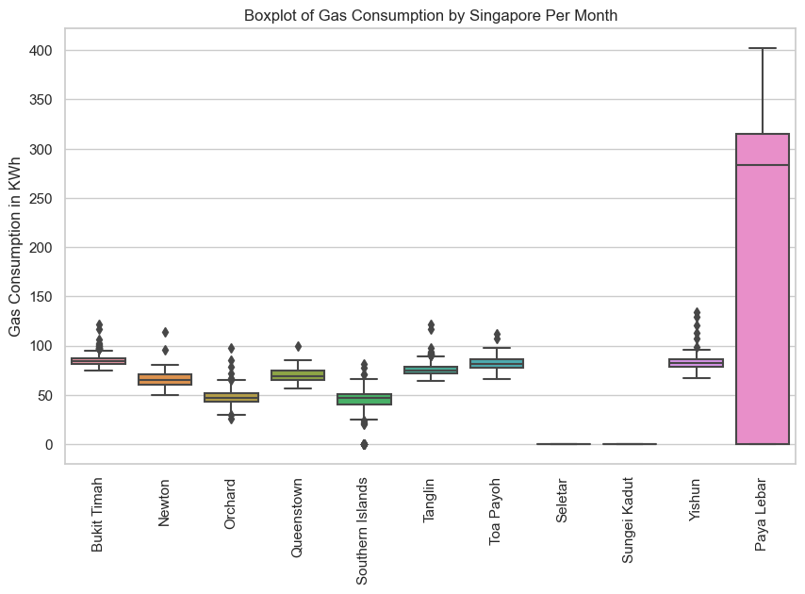

Slide 23
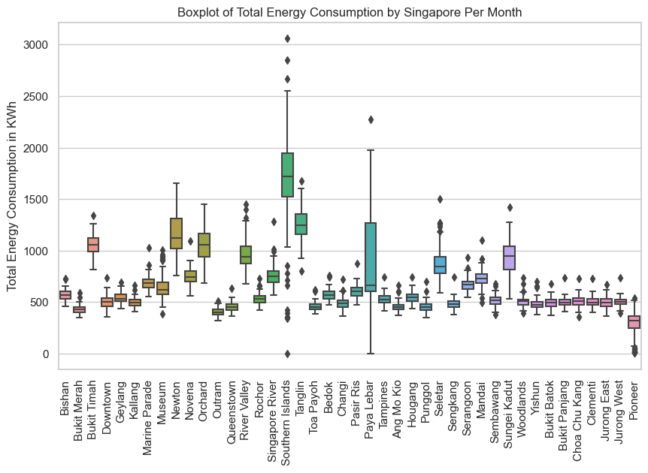
mean
648 kWh per month

